Slide 1
GAMIFYING MHapps
WHY & HOW

Slide 2
The Need
Mental illness is a growing concern: PREVENTION is key
More than 50% of effected people do not seek treatment
New interest in technology: accessible, anonymous, cheaper, effective, features, monitoring
Currently, there are no national standards for evaluating the effectiveness of MHapps

Slide 3
Target users
Preventive
Therapeutic
General population
People who will benefit from therapy

Slide 4
Experience
Fun, encouraging, empowering, enabling and educational
Respondent Vs. Operant
Have different options
Notes:
In cases of respondents (which typically include emotional reactions such as anxiety, depression, anger), consequences play a minimal role as compared to operants (where consequent reinforcements paly an important role, such as when rewards are used to promote a desired behavior) (Bellack, Hersen, & Kazdin, 2012).

Slide 5
Recommendations for MHapps
Apps need to be CBT (cognitive behavior therapy) based
They should allow automated tailoring
Be easy to use by non-clinical populations
Make use of gamification elements to motivate and engage users
Have links to support services

Slide 6
Recommendations for MHapps
Provide the capability to record or report mood/feelings, thoughts and behavior
Recommend activities, reminders
Built in triggers to engage the user
Encourage non-technology based activities
Have a log of past app use
Conduct experimental trials to establish efficacy
(Bakker, Kazantzis, Rickwood, & Rickard, 2016)

Slide 7
Gamification
Gamification is ‘’the use of game mechanics and experience design to digitally engage and motivate people to achieve their goals”.
Gartner
Notes:
Game play is a natural part of being human. It provides opportunities for social interaction, competition, collaboration, enjoyment, problem solving, feeling of achievement

Slide 8
Notes:
https://www.youtube.com/watch?v=7ZGCPap7GkY

Slide 9
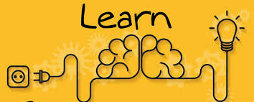
ENGAGEMENT KNOWLEDGE RENTENTION
AND ABSORPTION

Slide 10
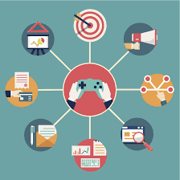
Advantages of Gamification
CLEAR GOAL
IMMEDIATE FEEDBACK
EVIDENCE OF PROGRESS
SKILL BUILDING
REWARD & REINFORCEMENT
ACTIVE LEARNING
SOCIAL ANGLE
Notes:
REALSITIC.
CHOUCE SHOULD BE THERE

Slide 11
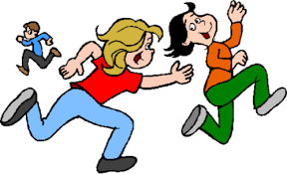
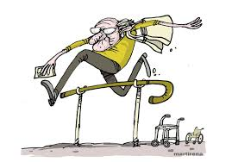
Forms of Gamification
Social interaction via games
Including challenges
Rewards (badges, positive feedback, virtual treats)
Notes:
Gamification stared in 1800s as a means to attract customers

Slide 12
Gamification Elements: electronic games
EG
EGP
(serious games)
EGE
(off-the-shelf games)
Notes:
EG and other technologies can provide effective, efficient and appealing interventions for variety of problems

Slide 13
Applied games
Nintendo
Exergames Movement based
Virtual reality multiple stimuli
CBT based serious games Interactive narrative
CBT based gamification Fun bite sized activities
Biofeedback Controlling physiology to play the game
Entertainment games Time pressure
Nintendo
Virtual Iraq
Journey to the Wild Divine
SPARX
SuperBetter
Goals: redirection, exposure therapy, cognitive restructuring
Notes:
Exergames: depressive symptoms in OA. Exercise, Social activity, behavioral activation
Sparx: fight negative thoughts (represented as creatures/gNats) replace with good thoughts (gems)
Biofeedback-exploration/VR

Slide 14
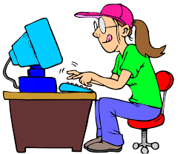
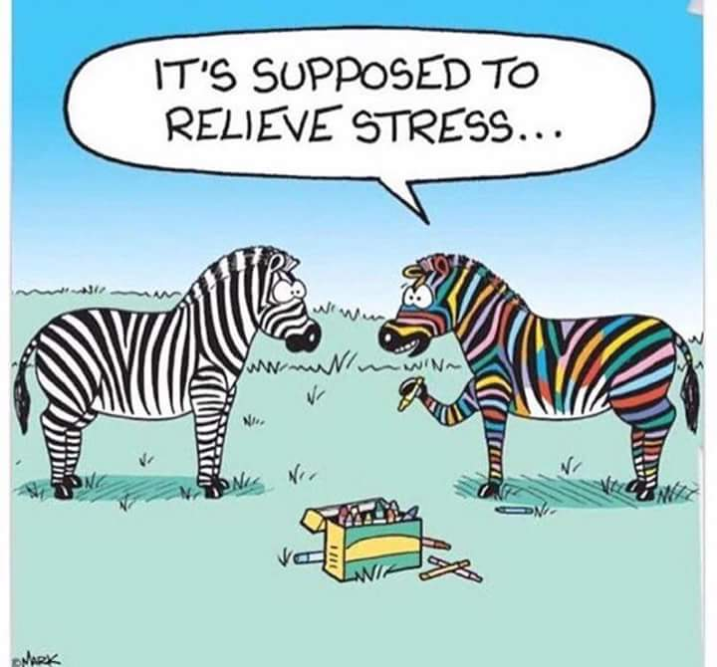
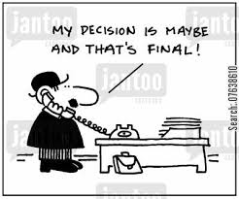
Gamification Elements: Videogame Play
Potential to enhance positive well-being
Games as facilitator in therapy (GB-CBT)
Improve attention
Decision making
Positive emotion
Skill building
Notes:
Action games low /moderate users have found benefit more than exceesice or never users. Moderate (7-10hrs) low (1-6). Adolscent boys- non gamers more at risk

Slide 15
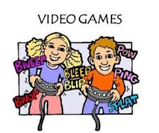
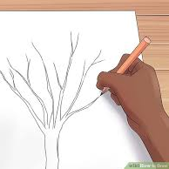
Gamification Elements: Videogame Play
Engagement, concentration, immersive
Used to manage anger, frustration, stress
Social aspect: multiplayer games
Insight generation
Included gross motor movements/action
Notes:
Does it distract? But also implicitly develop required skills by strengthening pathways? Drawing, pottery,etc have similar insight generating, calming effect

Slide 16
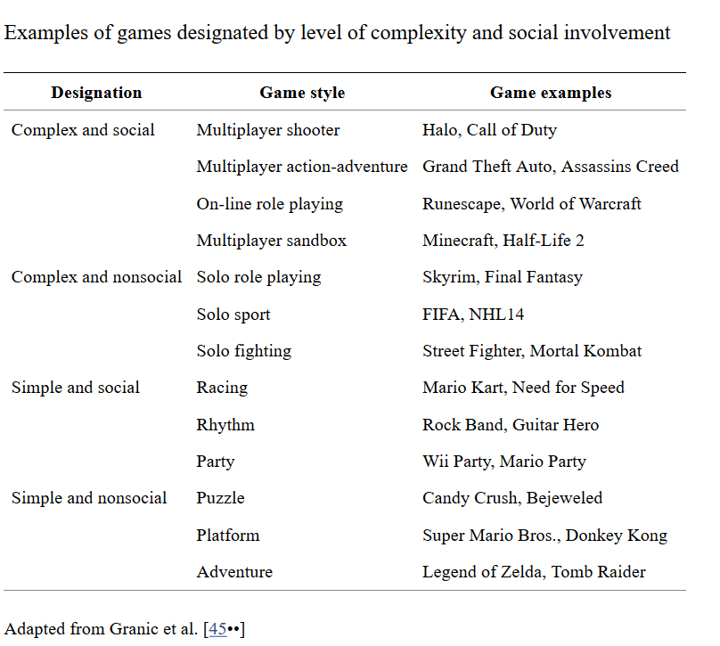
Gamification Elements: Videogame Play
Notes:
Example cases:
Anxiety – simple non social
Aggression, poor social problem solving -Complex non social- the wizard and the princess and alter ego

Slide 17
Gamification Elements: Videogame Play
In moderation
How Transferable are the skills?
How lasting are the effects?
Do they work in eliminating the root cause?
Best when used in combination with other
Notes:
When used in conjunction with other forms of therapy, effect is commendable. Eg- experiences int eh game can be applied to real life situations

Slide 18
Scenario
Steve is a 17 year old boy. Had a rough day at school. Was feeling anxious and frustrated. Usually, he would go throw some hoops in the neighborhood basketball court, or play a game, but he was too keyed up to concentrate on either of those. He felt like talking to someone, someone he could trust and would not judge him. But there was no one around. As he was fidgeting with his cell, he came across an app that he had downloaded a few weeks back on the recommendation of a friend. He decided to try it.

Slide 19
positive message
Emotion/mood reading
Choice of activity
Activity
Mood reading
Choice of activity
Close with affirmation
Notes:
Activity (based on research & personal profile)

Slide 20
Conclusion?
Apps will become more efficient
Multiple modalities will continue to be used
Novel ways of delivery will continue to be invented
Human intervention will always be needed at some point
A professional intervention method (Therapeutic technique/s) will almost always be required to deal with the root cause. All other elements will help enhance/speed up its effect
Notes:
Instruction based drawing, gesturing, desensitization through simulations, VR to make it realistic, some people may not like gamified versions . May find it corny

Slide 21
REFERENCES
Horne-Moyer HL, Moyer BH, Messer DC, Messer ES. The Use of Electronic Games in Therapy: a Review with Clinical Implications. Current Psychiatry Reports. 2014;16(12):520. doi:10.1007/s11920-014-0520-6.
Jones, Christian M., Scholes, Laura, Johnson, Daniel, Katsikitis, Mary, & Carras, Michelle C. (2014) Gaming well: Links between videogames and flourishing mental health. Frontiers in Psychology, 5(260), pp. 1-8.
McGonigal, J. How Video Games Can Teach Your Brain to Fight Depression Nov 2015 http://www.slate.com/articles/technology/future_tense/2015/11/how_video_games_can_teach_your_brain_to_fight_depression.html

